Slide 1
Final Project-Part2
Accelerate Convolution Neural Network with CUDA
NCTU 2017 Fall Computer Architecture
TA： Jyun-Wei Pan
Email：s0550233.ee05g@g2.nctu.edu.tw
Lab： Parallel Computing System - ED520

Slide 2

Outline
Sparsity in Sparse Convolution Neural Network
Sparse format
Assignment
Grading Policy
Reference

Slide 3
Outline
Sparsity in Sparse Convolution Neural Network
Sparse format
Assignment
Grading Policy
Reference

Slide 4
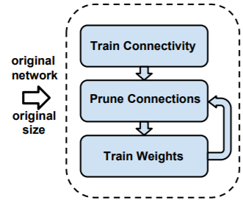
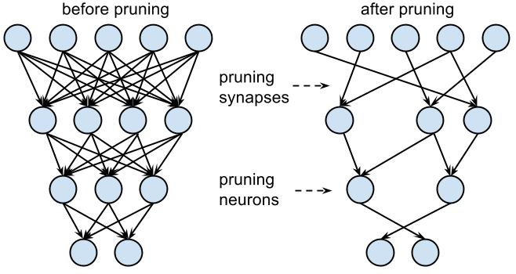
Sparsity in Sparse Convolution Neural Network
Sparsity in filter
Lots of weights are very close to zero.
Pruning and Retraining

Slide 5
Sparsity in Sparse Convolution Neural Network
Sparsity in neuron
The negative value will be change to zero through the RELU function.

Slide 6
Outline
Sparsity in Sparse Convolution Neural Network
Sparse format
Assignment
Grading Policy
Reference

Slide 7
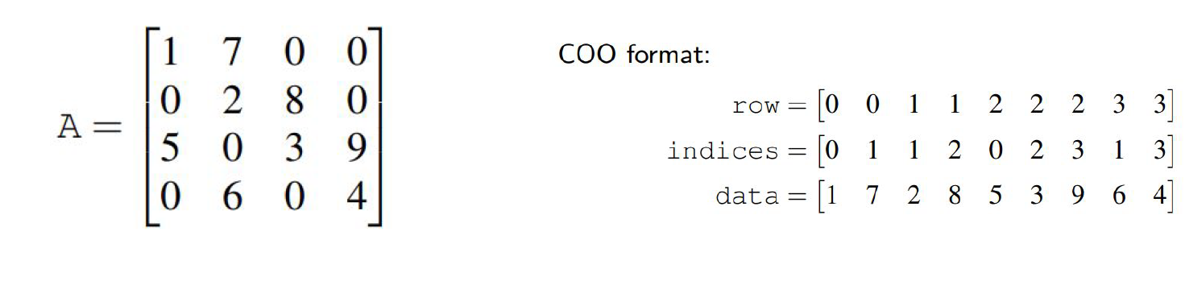
Sparse format
In part2, TA provides the same data set in COO format.
Actually , there are other sparse format Ex: CSR、CSC、ELL、DIA.

Slide 8
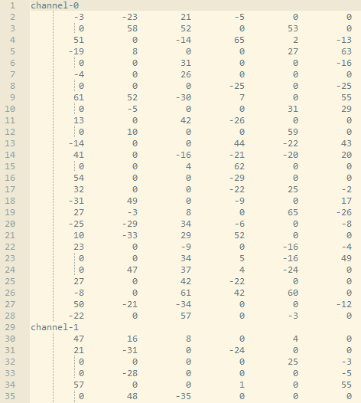
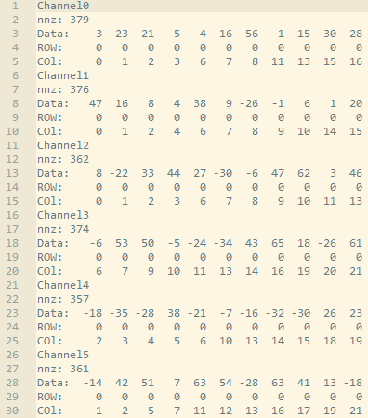
Neuron_COO.txt

Slide 9
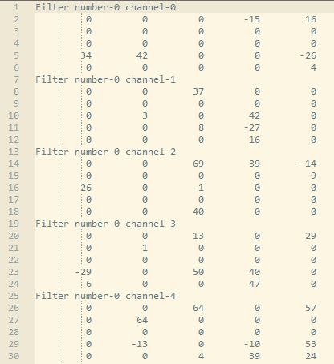
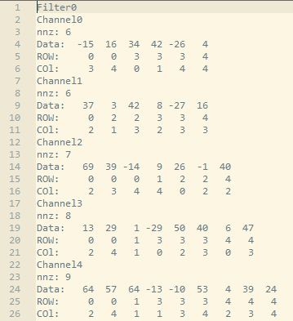
Filter_COO.txt

Slide 10
Outline
Sparsity in Sparse Convolution Neural Network
Sparse format
Assignment
Grading Policy
Reference

Slide 11
Assignment
Task：Implement Sparse convolution , relu , and maxpooling in convLayerGPU() with CUDA
and store your result in the outGPU and use NVVP to analyze your code.
Base Program：
Three sub-directories under the source directory
./device contains a program that can show you device information.
./example contains the CUDA Inner Product and Matrix Multiplication examples.
./data contains the input data for the base program.
Two major files for base program
CNNConvLayer.cu and CNNConvLayer.h
Usage
Compile the code：“make”
Run the code：“make run”

Slide 12
Two input data files (Please do not modify the input data)
./data/filter_COO.txt storing sparse filters’ values
./data/neuron_COO.txt storing sparse neuron’ values
initCoo() will read the input data
convLayerCPU() will do the same computation with C++ and store the output in the outCPU.
checker() will check whether the values stored in outCPU and outGPU are the same.
clock_gettime() is used to measure your preformance
Lunch your CUDA kernel within two clock_gettime() functions
Put cudaDeviceSynchronize() before the last clock_gettime()
You must pass the checking to ensure your result is correct!
We will compare the execution time to get the speedup
Speedup = convLayerCPU_execTime / convLayerGPU_execTime
convLayerGPU_execTime includes : cudaMalloc time 、cudaMemcpy time and execution time. Please put these functions between clock_gettime(CLOCK_REALTIME, &time_begin) and clock_gettime(CLOCK_REALTIME, &time_end).

Slide 13
Other Rules
1. It’s a team work, 1 ~ 4 people in one team.In part2, you can change your team.
- Register here before deadline
2. Compress your code and report into one zip file and upload to E3.
3. Name your report as：LeaderID_Report_FP2.pdf
4. Name your package as： LeaderID_FP2.zip
5. One team only need to upload one package to E3.
6. Make sure TA can compile and run your code with “make” and “make run” on the
provided server
7. Any CUDA library is forbidden to use in this project !!!
8. DELAY IS NOT ACCEPTABLE !!!

Slide 14
Environment
Get base program source code with below command：
$ git clone https://github.com/s0606757/CA2017FP-Part2.git
We provide you a linux server with NVIDIA GPU K20：
IP: 140.113.225.118 SSH Port: 22
Account：ca01~58 (Account List)
Remember to enable X11 forwarding when you connect to the server for using the
NVIDIA Visual Profiler.
Your code will be evaluated on this server.
Due day：2017/11/30 (Thr) 23:50

Slide 15
Outline
Sparsity in Sparse Convolution Neural Network
Sparse format
Assignment
Grading Policy
Reference

Slide 16
Grading Policy
(A) Completeness (35%)
Your result(convLayerGPU) must be correct (Pass the check) (10%)
Your design(convLayerGPU) is faster than convLayerCPU() (15%)
Use your data format(10%)
(B) Report (35%)
Describe your implementation algorithm and explain your results (15%)
Discuss what kind of optimization you did( it is better or worse?) (10%)
Show how you use NVVP to help you find and solve perf. issues (5%)
Feedback of this part (5%)
(C) Performance Rank (30%)
We will rank your CUDA kernels’ performance(execution time) on GTX K20C
The fastest one will get 30% and the last one will get 1%

Slide 17
Outline
Sparsity in Sparse Convolution Neural Network
Sparse format
Assignment
Grading Policy
Reference

Slide 18
Refernece
Neural Network Pruning
Sparsity in Neurons
Sparse Foramat in Matrix Multiplication
Implement Sparse Matrix Multiplication with Cuda
An Accelerator for Sparse CNN
Sparse Format – Nvidia
Coda-Debugging Command Line

